Slide 1

QAUNTUMVERA

Slide 2
MEET THE TEAM
Siyamazi Kheswa
Lindokuhle Njoko
Mnqobi Khuboni
Letlohonolo Mosia
Malwande Mthenjana

Slide 3
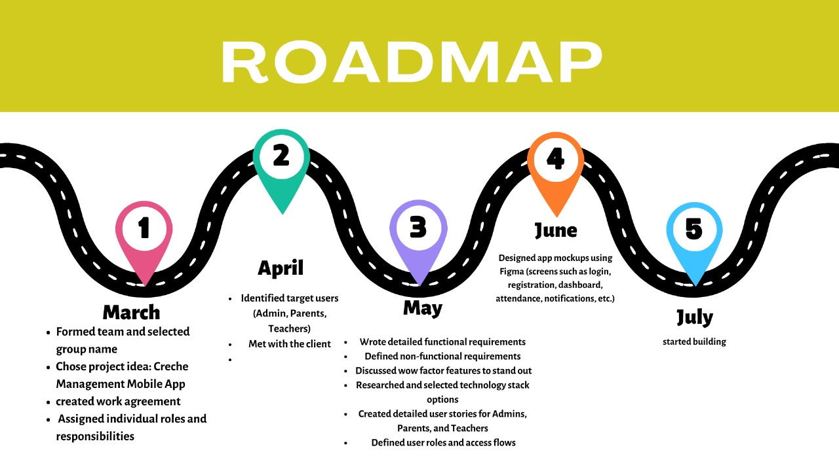

Slide 4
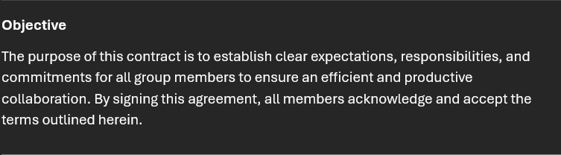
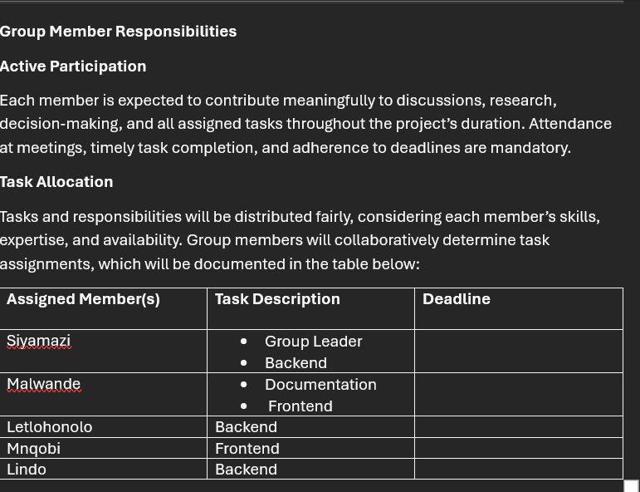

WORK AGREEMENT

Slide 5

CLIENT EXPECTATIONS

Slide 6
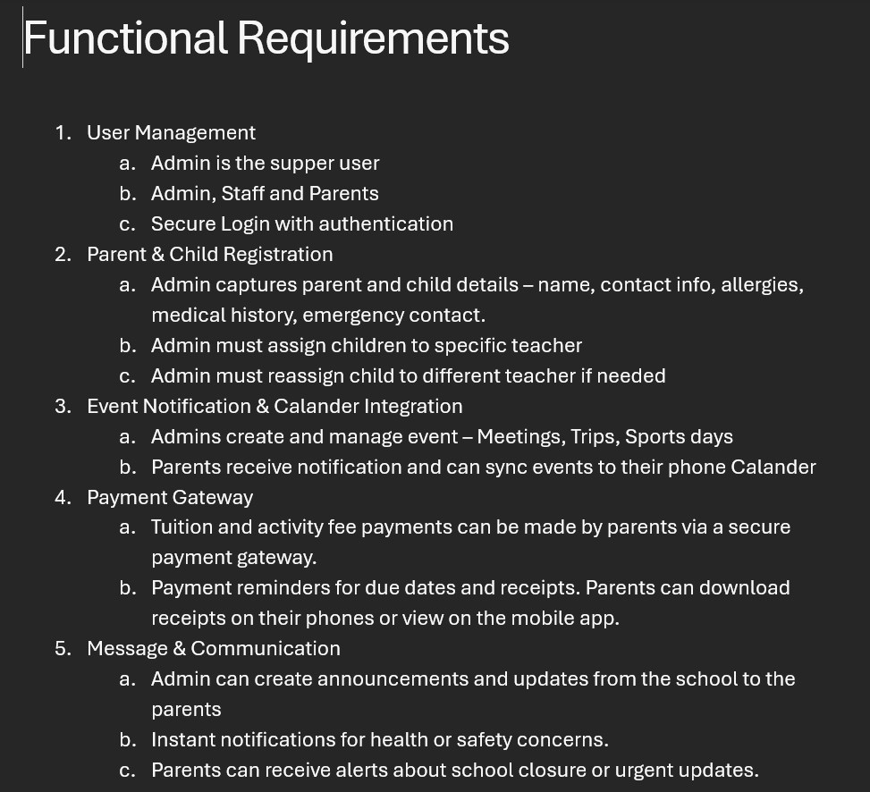
Functional and non-functional requirements

Slide 7
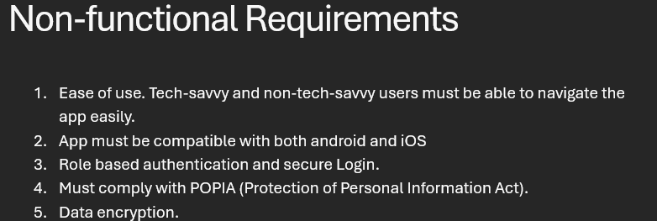

Slide 8
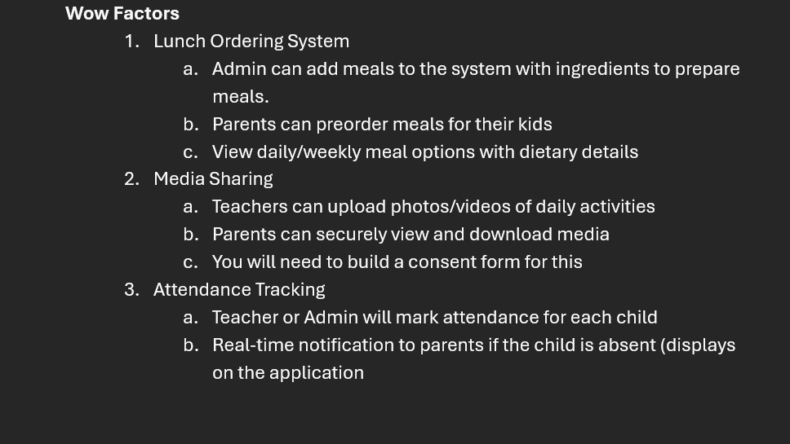

Slide 9
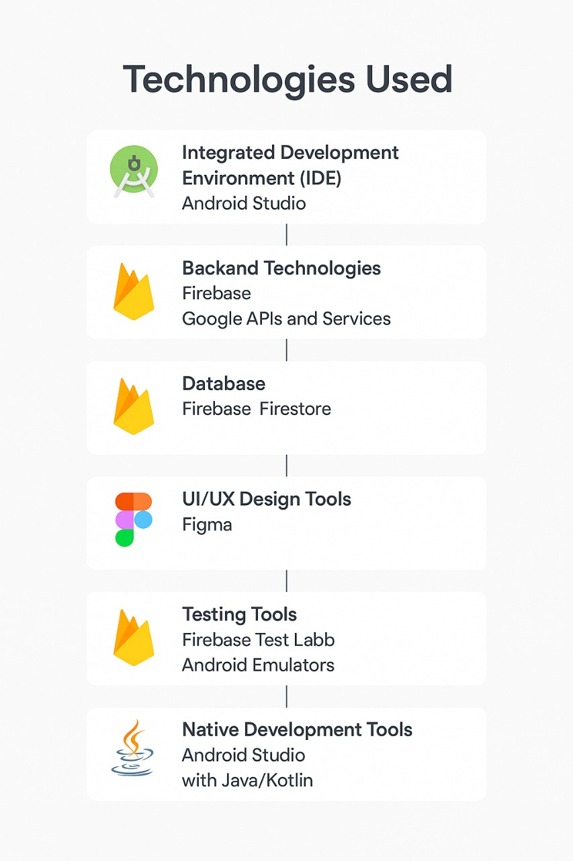

Slide 10
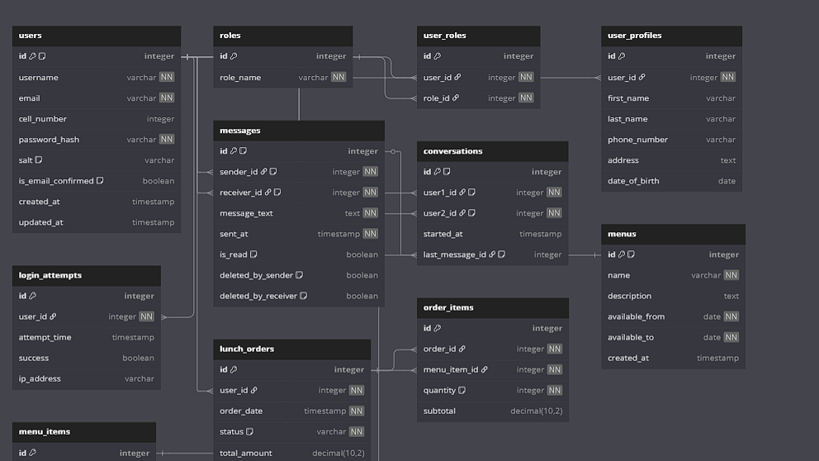

Slide 11
LINKS TO:
GitHub https://github.com/LindoNJOKO/QuantumVara-WIL-Project
Non-functional Prototype https://www.figma.com/design/E5Nq3ZTaNsAxXlR58OtX0l/NURTURE-NEST?node-id=0-1&m=dev&t=nOMG8L5vKszh85Fn-1

Slide 12
THANK YOU

